Slide 1
Plant Vs Zombie game Object-oriented programing
By DEEP TRY GROUP

Slide 2
GROUP MEMBERS
Do Minh Duy – ITITSB22029
Phung Huy Quang – ITITWE22145
Luong An Khang – ITITWE22104
Phan Minh An – ITITSB22028

Slide 3
Game sumary
Tower defendse game
4 main levels
Main object: protect your home from zombies
Java coded
Supported by Greenfoot

Slide 4
Game play, characters,Levels,Runing platform
01
Characters
02
Game play
03
Levels
Plants: Sunflowers, Peas Shooters, Potato Mines, Walnuts
Zombies: Basic Zombies, Conehead Zombies, Buckethead Zombies, Brickhead Zombiez
Using sun in oder to plant the Plants to defense your home the Zombies approaching
04
Runing platform
We using GreenFoot application in oder to run the game
There are 5 levels for you to play through, at each level you will achieves a new Plant to help you get through the round

Slide 5
A few ingame image

Slide 6
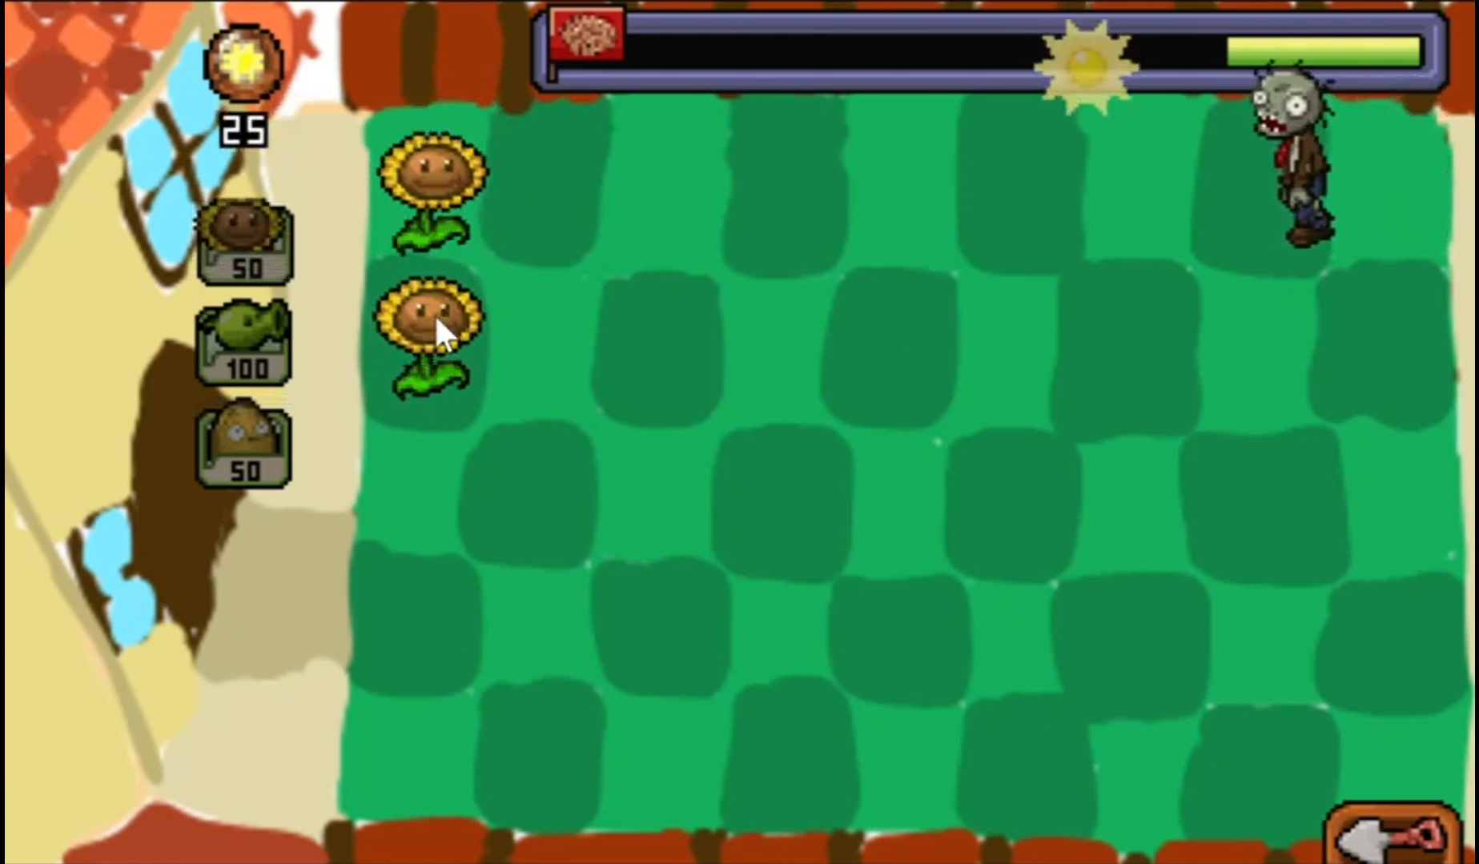
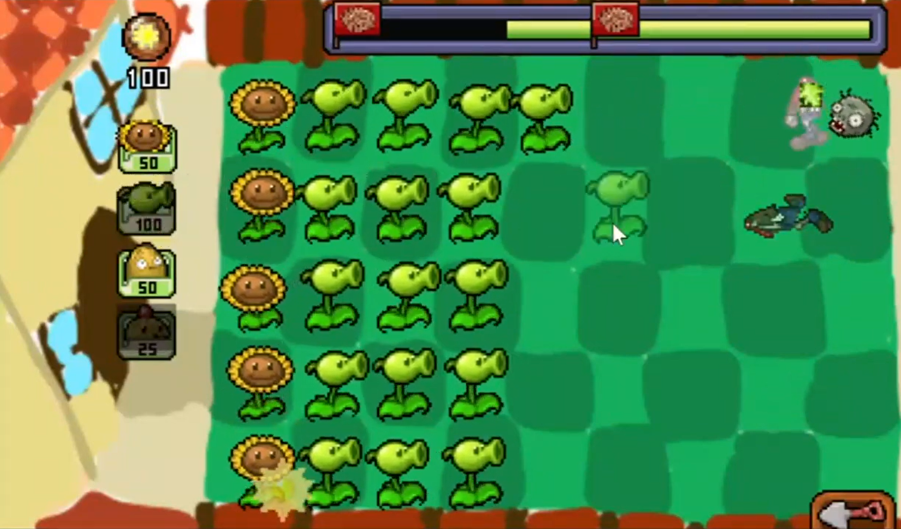
Check out our youtube game play video here:https://youtu.be/TUH8KEWjI2w?si=l_hLIPwBMnqfYGYu

Slide 7
UML GITHUB GREENFOOT

Slide 8
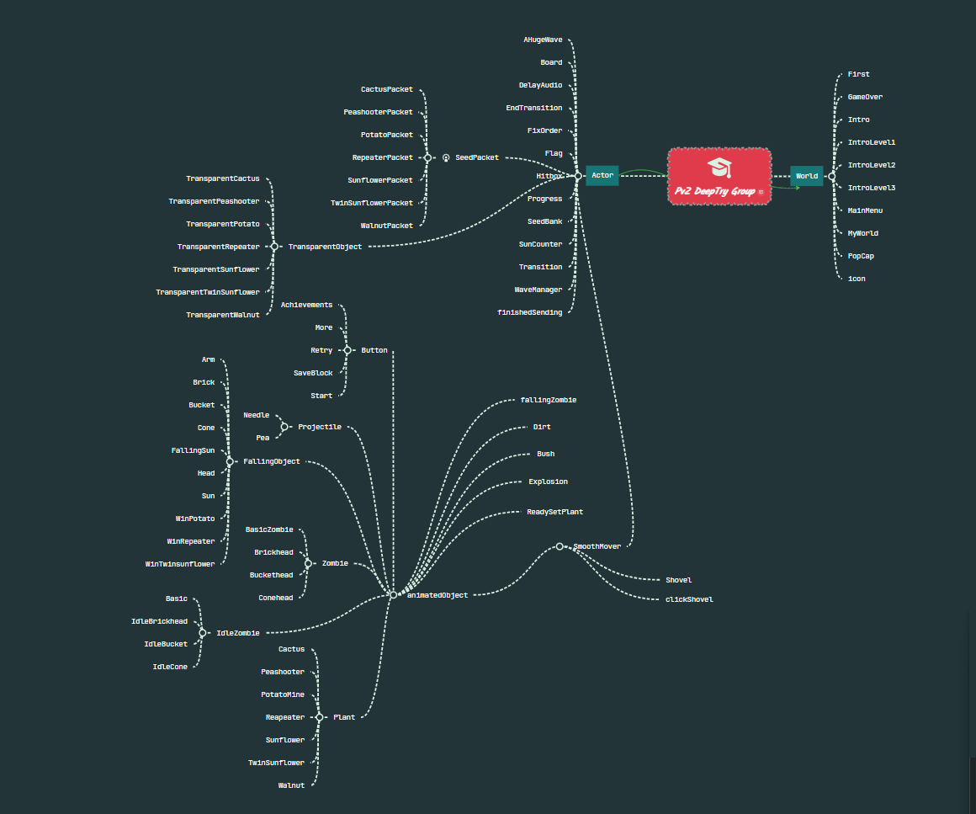
UML

Slide 9
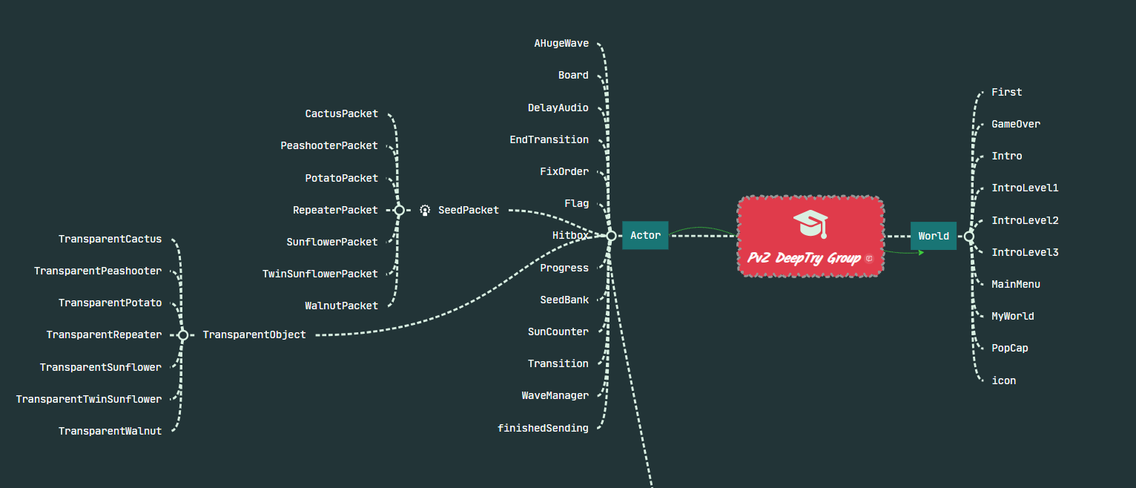

Slide 10
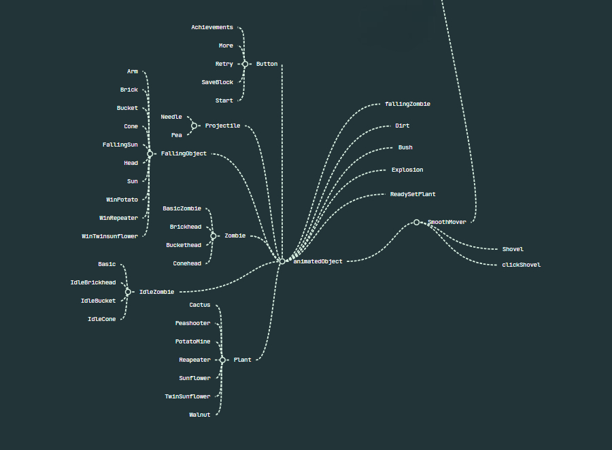

Slide 11
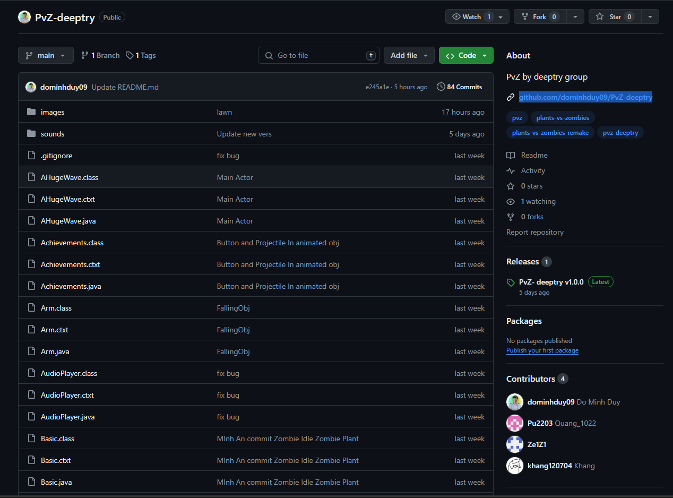
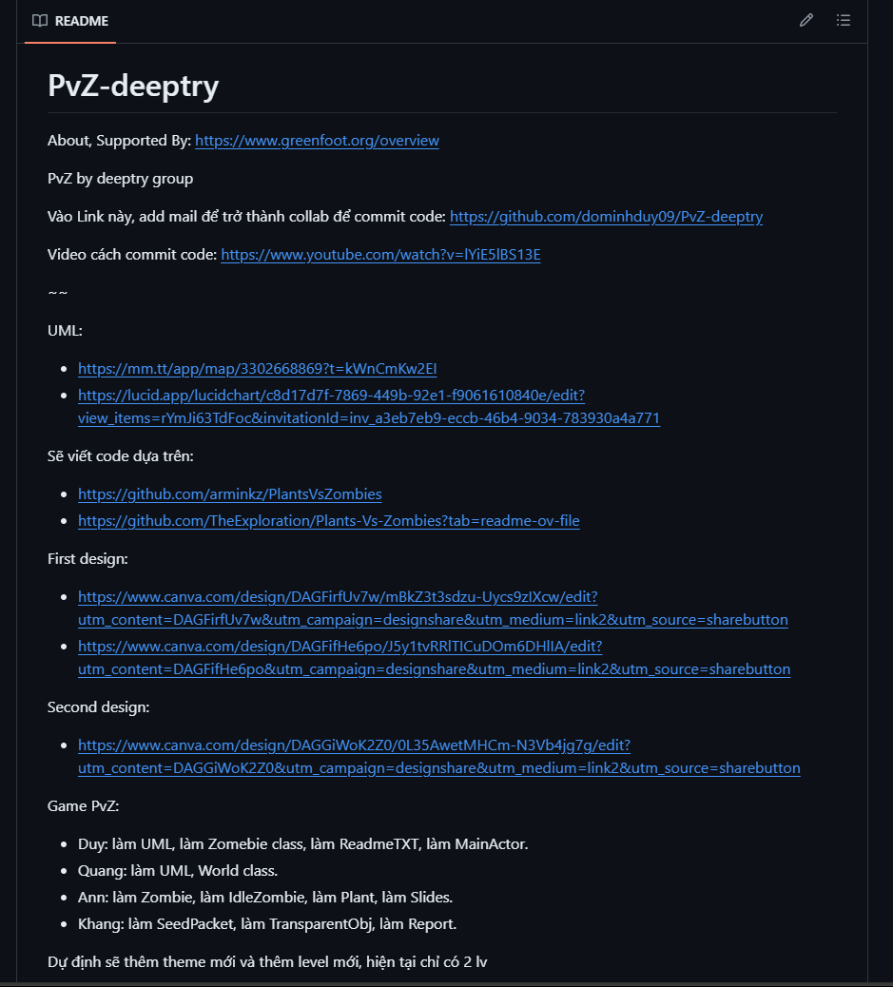
GITHUB
OUR GITHUB LINK: github.com/dominhduy09/PvZ-deeptry

Slide 12

GREENFOOT
GREENFOOT APPLICATION: https://www.greenfoot.org/overview
04
Greenfoot is an educational tool for learning Java. It’s interactive, user-friendly, and perfect for beginners. Highly recommended for budding coders!

